Slide 1
P0 with Exceptions
Slides and Demo Prepared by
Fanping Jiang, Meijing Li, Kevin Zhou
Instructor: Dr. Emil Sekerinski
Course: Computer Science 4TB3
Dept. of Computing and Software, McMaster University
April, 2022

Slide 2
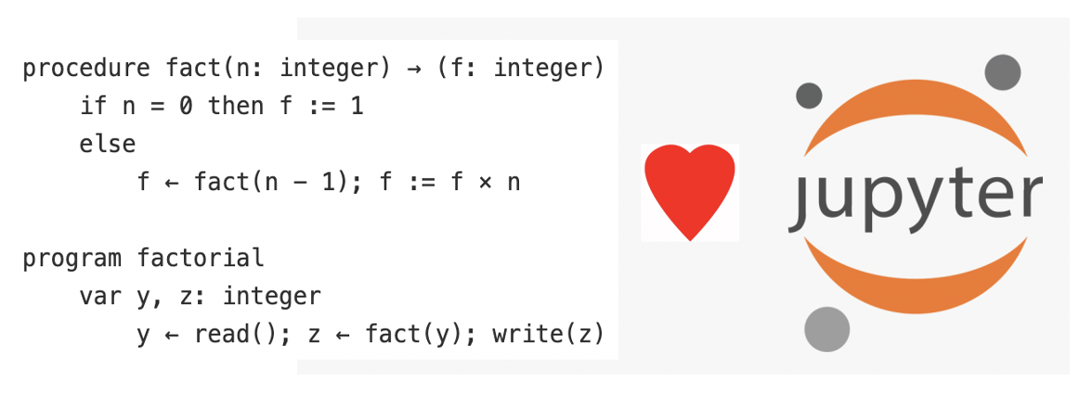

Background
Exceptions
Handle errors at runtime
Alter the flow of the program
A fundamental element of coding
P0
Python based Compiler
Generates WebAssembly and MIPS
Missing exception handler while generating WebAssembly code!

Slide 3
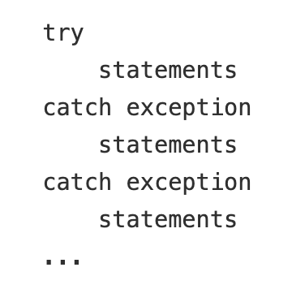
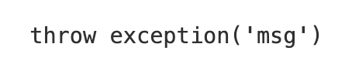
Adding Exceptions to P0
try-catch Block
throw Clause

Slide 4
Types of Exceptions
Pre-Defined Exceptions:
ZeroDivisionError: Division by 0
IndexError: Indexing exceeding the range
TypeError: Operator is applied to an operand of inappropriate type
NameError: Variable name is not defined
SyntaxError: Syntax of the expression is not correct
...
Customized Exceptions: Exception thrown by the users

Slide 5
Challenges
**TODO: Challenges that met during the project**
**TODO: Challenges that met during the project**
**TODO: Challenges that met during the project**
**TODO: Challenges that met during the project**

Slide 6
Demo

Slide 7
Documentation & Comments
Project description with implementation in details
Comments around each functions / classes
Bibliography
**TODO**

Slide 8
Testing
Testable artifacts are provided (under the project repo)
Simply clone the repo and push all the notebooks on JupyterHub
Test cases are provided in a single notebook

Slide 9
Resources
WebAssembly/exception-handling (Github repo)
Anaconda (for deploying Jupyter to local machine)
The Jupyter Notebook - Official Documentation of Jupyter Notebook
P0 Source Code

Slide 10

Visit Us
https://gitlab.cas.mcmaster.ca/cs4tb3-winter22/group-12
Fanping Jiang, Meijing Li, Kevin Zhou

